Slide 1

Live Demonstration of Wi-Fi Jamming using Node MCU
Team Members:
Sandesh Basnet
Aayan K.C
Aaditya Roila
Ronak Kunwar

Slide 2

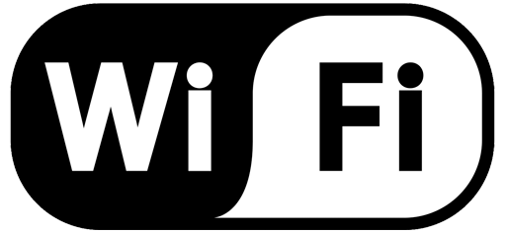
Introduction to Wi-Fi Jamming
1
Disruption of Wireless Signals
2
Signal Interference
3
Network Outage
Jamming devices emit strong signals that overwhelm legitimate Wi-Fi signals, disrupting connectivity.
Devices within range of the jamming signal experience connectivity issues, resulting in dropped connections.
Wi-Fi jamming involves intentionally interfering with wireless communication signals.

Slide 3
Principles of Wi-Fi Jamming
Frequency Overlap
Signal Strength
Signal Interference
Jammers operate on the same frequency bands as Wi-Fi networks.
Jamming devices transmit signals with higher power, overpowering legitimate signals.
The interference disrupts the communication between devices and access points.

Slide 4
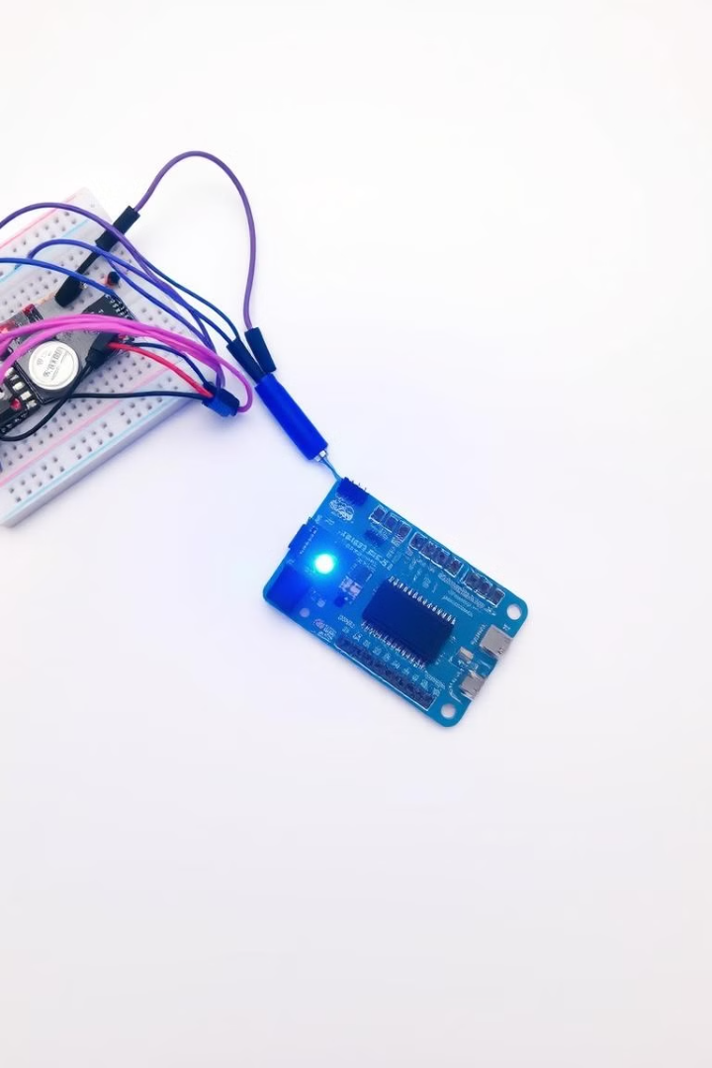
Overview of Node MCU
Microcontroller
Wi-Fi Connectivity
The Node MCU is a low-cost, open-source microcontroller platform.
The Node MCU incorporates a Wi-Fi module for network communication.
Programming Flexibility
The Node MCU is programmable using the Arduino IDE and supports various programming languages.

Slide 5

Hardware and Software Setup
1
Node MCU Board
Acquire a Node MCU board and a USB cable to connect to your computer.
2
Arduino IDE
Download and install the Arduino IDE, a software environment for programming microcontrollers.
3
ESP8266 Libraries
Install the necessary ESP8266 libraries within the Arduino IDE for Wi-Fi functionality.
4
Wi-Fi Jamming Code
Obtain the Wi-Fi jamming code, which is a program that instructs the Node MCU to jam signals.

Slide 6




Preparing the Node MCU for Jamming
Connecting the Antenna
Attach an antenna to the Node MCU board to enhance signal transmission and reception.
Uploading the Code
Copy the Wi-Fi jamming code into the Arduino IDE and upload it to the Node MCU.
Configuring the Jammer
Adjust the code parameters, such as the jamming frequency and power level.

Slide 7




Executing the Wi-Fi Jamming Code
Code Execution
Run the uploaded code on the Node MCU, initiating the jamming
process.
Signal Emission
The Node MCU will start transmitting jamming signals, disrupting
nearby Wi-Fi networks.
Network Disruption
Devices within range of the jamming signal will experience connectivity issues and interruptions.

Slide 8

Observing the Jamming Effects
Devices
Effects
Smartphones
Lost Wi-Fi connectivity, dropped calls, slow data speeds
Laptops and Computers
Interrupted internet access, inability to connect to Wi-Fi networks
Internet of Things (IoT) Devices
Disrupted functionality, inability to communicate with the network

Slide 9
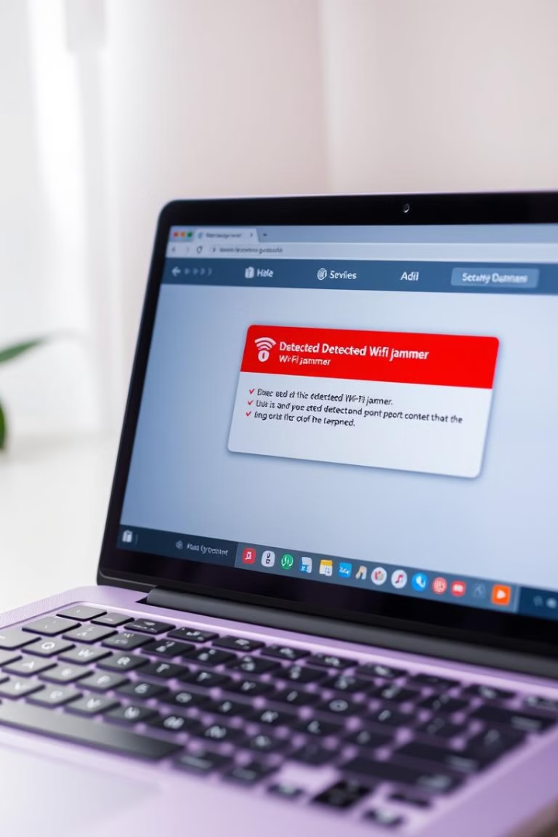
Mitigating Wi-Fi Jamming Techniques
1
Signal Strength
2
Frequency Hopping
Maintain a strong Wi-Fi signal by positioning routers strategically and using high-gain antennas.
Utilize Wi-Fi networks that employ frequency hopping spread spectrum (FHSS) technology, which automatically changes frequencies.
3
Security Measures
Implement robust security measures, such as strong passwords and encryption, to minimize the impact of jamming.

Slide 10

Ethical Considerations and Responsible Use
Illegal Activity
Privacy Violations
Wi-Fi jamming is illegal in many jurisdictions and can lead to serious consequences.
Jamming can disrupt essential services, such as emergency communications and healthcare systems.
Responsible Use
Wi-Fi jamming should only be used for educational purposes and with proper authorization.

Slide 11
Live Demonstration of
Wi-Fi Jamming using
Node MCU
ESP 8826

Slide 12
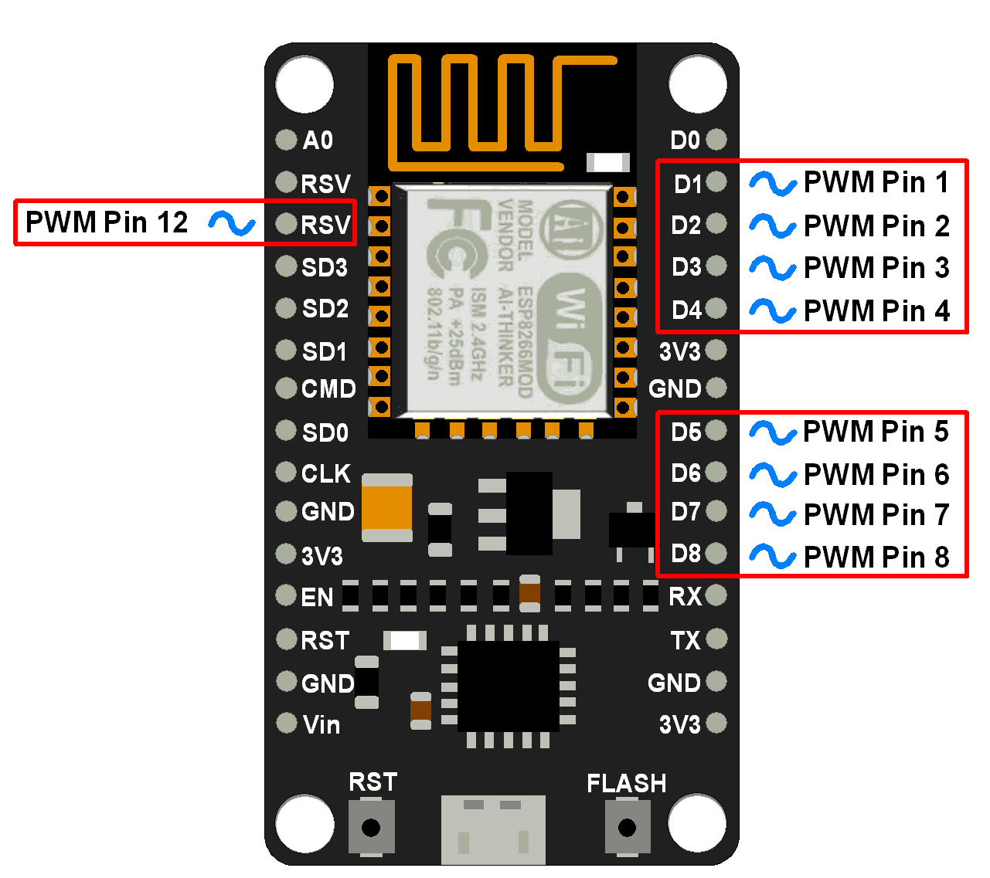
QNA
Feel Free To Ask Us Any
thing Related to
this presentation.

